Slide 1


Visualizing
the popularity of content categories

Slide 2


Today's agenda
Project recap
Problem
The Analytics team
Process
Insights
Summary

Slide 3

Social Buzz is fast growing unicorn tech company that need to adapt to its global scale.
Accenture has began a 3 month POC dealing with:
- An audit of their big data practice
- Recommendations for a successful IPO
- An analysis of Social Buzz’s top 5 most popular categories
Project Recap

Slide 4

Problem
Over 100,000 text, images, videos and GIFs contents daily. 500 million active users each month. How to manage all of this highly unstructured data with limited internal resources.
Analysis Social Buzz’s top 5 content category.

Slide 5




Andrew Fleming
(Chief Technical Architect)
The Analytics team
Marcus Rompton (Senior Principle)
David Owino
(Data Analyst)

Slide 6
Process
Data understanding-analyze the background information provided to understand the requirements
1
2
Data cleaning-clean the 3 datasets to prepare them for modelling and analysis
3
Data modelling-model and merge datasets to create valuable insights for the client
Data analysis- explore the data to discover trends and patterns relevant to the question
4
5
Uncover insights- determine the answer to the client’s business question and present the findings

Slide 7
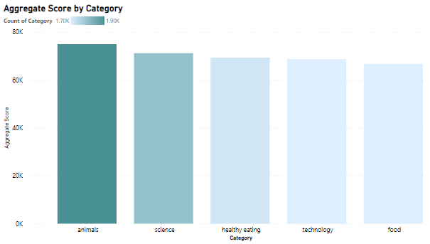

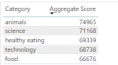
Insights
There are 16 unique categories
The following are the top 5 categories

Slide 8
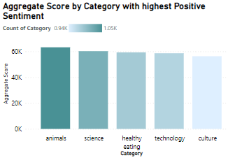
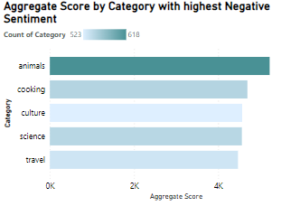
The top 5 categories by Positive and Negative Sentiments

Slide 9
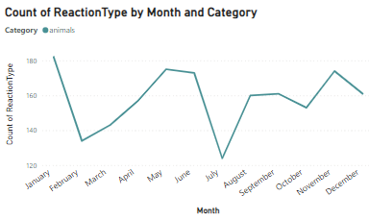
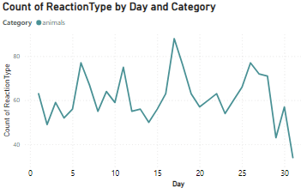
Number of reactions by top category by Month and Day

Slide 10

The top categories in terms of score are animals, science, healthy eating, technology and food
‘animals’ is the top category by positive and negative Sentiments
Summary
The top most category had the highest reactions on the month of January and on the 17th day of the month.

Slide 11
Thank you!
ANY QUESTIONS?

